Slide 1
Compiler Design , Computation

Slide 2
Presented By
Nopa Islam
Id : 011 151 062
Sukannya Saha
Id : 011 151 079

Slide 3
Compiler
Converts instructions into a machine code
Types of code compiler does
a. Source Code
b. Object Code
c. Byte Code
d. Machine Code
e. Micro Code
Compiler design covers basic translation mechanism ,error detection & recovery

Slide 4
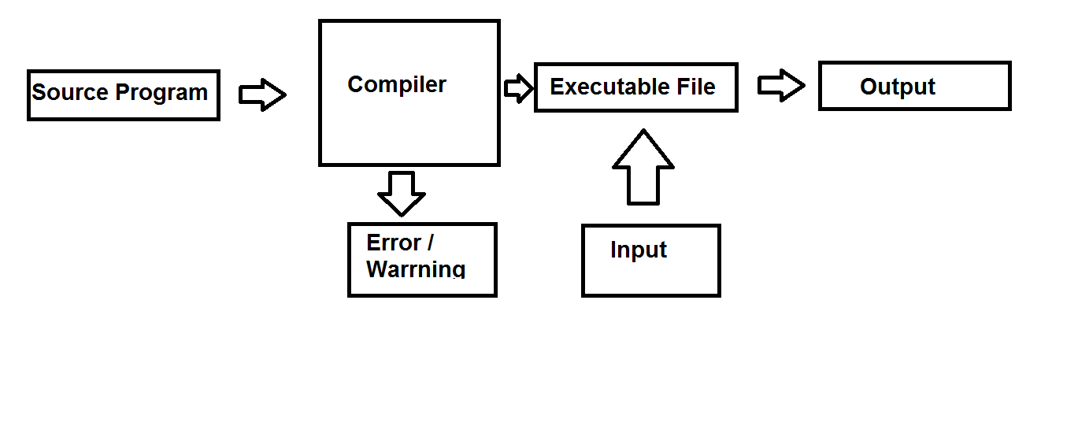
Compiler Flow

Slide 5
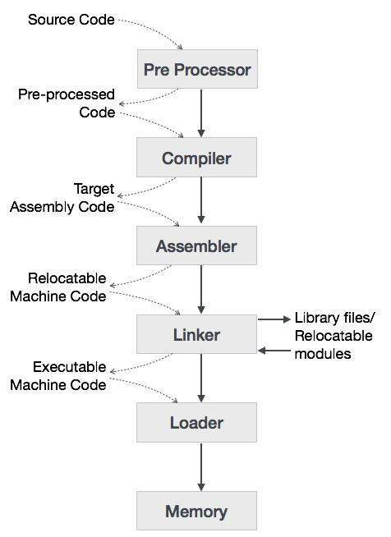
Steps Of Compiler

Slide 6
Steps Of Compiler
Preprocessor : Modifies data conform with input requirements
Compiler : Does the critical operations
Assembler : Low level Code -> Machine Code
Linker / Loader : Loader reads.exe code in memory. Linkers link & merge object files
Memory : Produced machine code holder .

Slide 7
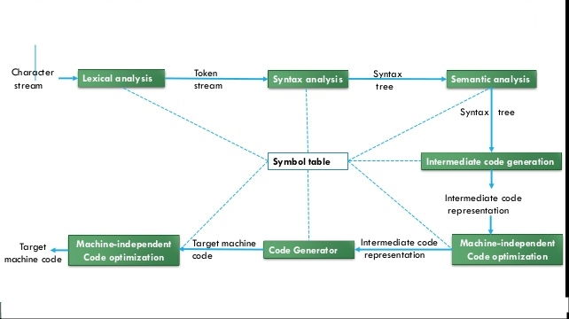
In A Nutshell

Slide 8
Main Part
Lexical Analysis : Sequence Of Characters -> Token Stream
Syntax Analysis : Generates hierarchy structures
Semantic Analysis : The heart of compiler, does
type checking
ICG : Generates 3 address code for precise representation
Optimization : Improves the intermediate code
Code Generation : Code generator takes intermediate code maps with the target language

Slide 9
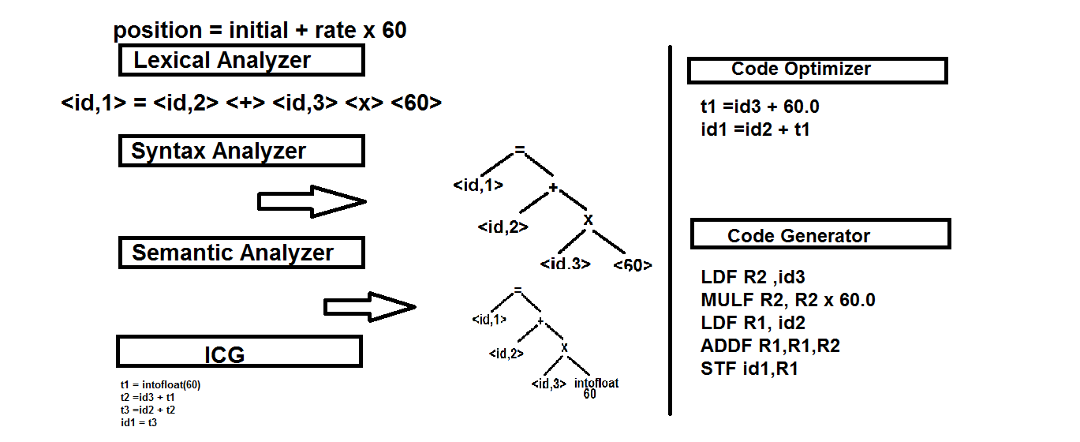
Overview

Slide 10
Error In Compiler
Lexical Error : Incorrectly typed identifier
Syntactical Error : Semicolon missed | unbalanced parenthesis
Semantical Error : Incompatible value assigns
Logical Error : Code not found , infinite loop

Slide 11
Error Recovery
Panic Mode : Prevent parser from developing infinite loop
Statement Mode : By taking corrective measures
parse ahead.
Error productions : Creating augmented grammar
Global corrections : Trying to find out a closest match
Abstract syntax tree : One kind of data structure, having least info’s.

Slide 12


Slide 13


